Slide 1
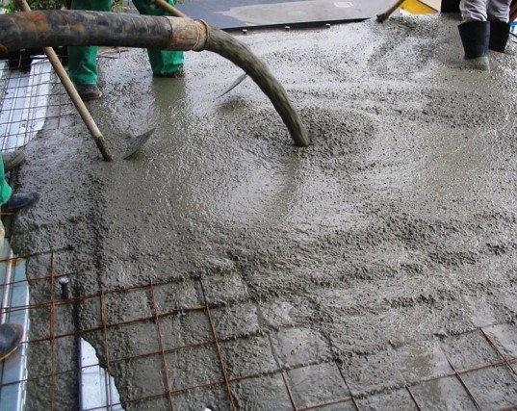

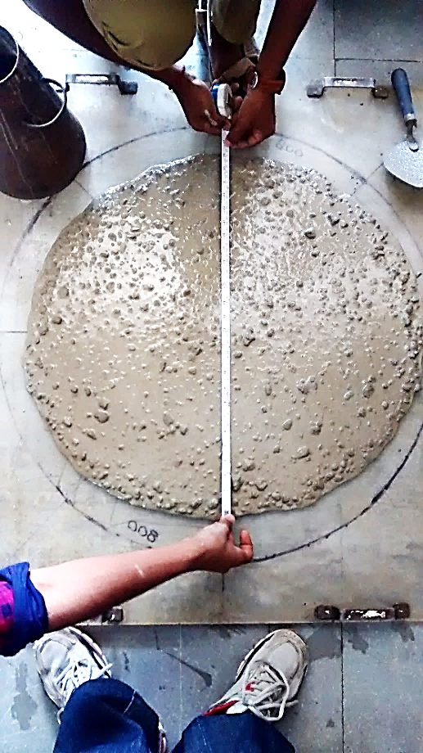
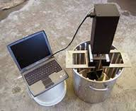
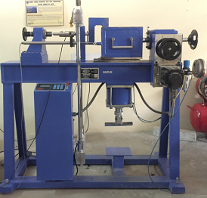
Innovative World of Concrete
ICI-IWC 2018
International Conference on
Innovations in Concrete
Bangalore
Paper ID : 44
“An Experimental Study to Investigate the Rheological Properties of fresh SCC using New Concrete Shear Box”
Presented by
Ajay.N
Research Scholar
BMS College of Engineering

Slide 2
Outline
Introduction
  Limitations of Slump Test
  Need for Rheology
  Concrete Rheology
Experimental Work
  Material Properties and Details of Mix Proportions
  Experimental Methodology
Results and Discussions
  Concluding Remarks
References

Slide 3
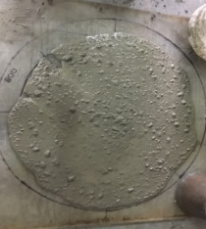
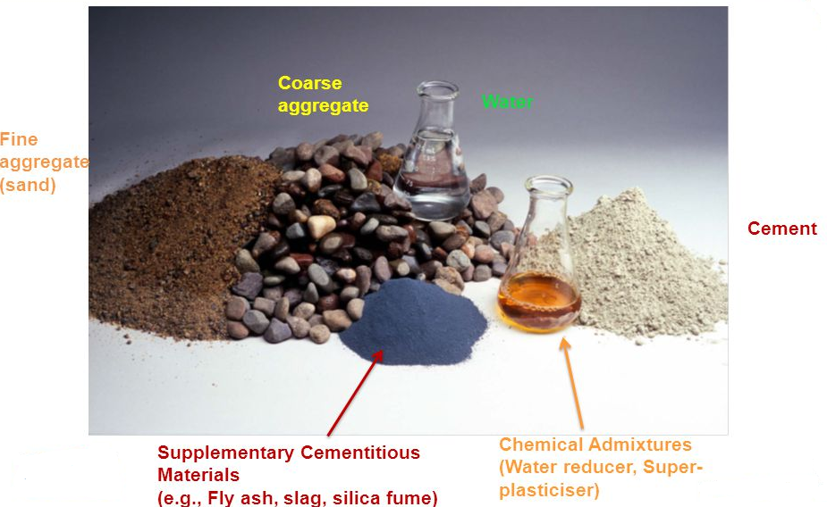
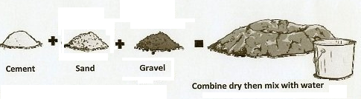
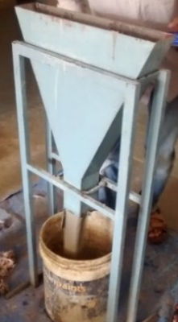
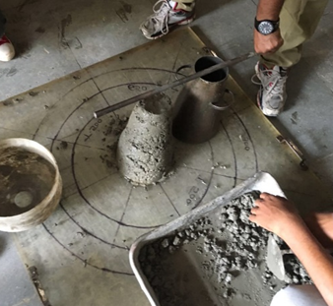
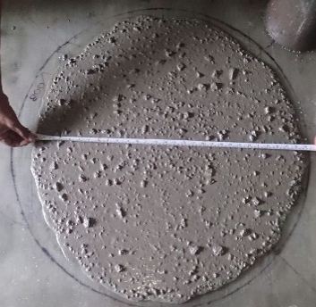
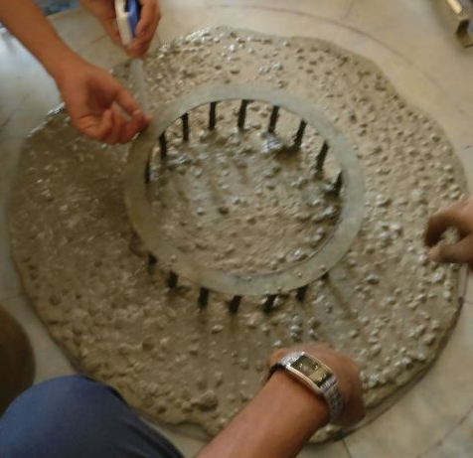

Introduction
Concrete is composite material.
4- basic ingredients.
Transformation from 4 ingredients to 6 or more ingredients.
In that fresh properties is more complex and critical.
Effect the Hardened properties.
Measuring the workability device – simple slump test.
With the current advancements in concrete technology, can the slump test still be considered a reliable measure of workability?
Though the test is simple, but it is quite incapable of differentiating two concretes mixes of different composition
CVC
HSC
SCC
HPC

Slide 4
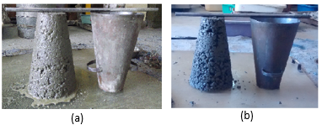
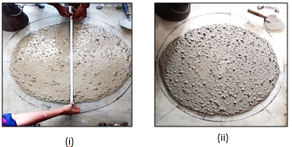
Is the slump test is capable of measuring workability?
Limitation of Slump Test
Not Differentiating the mixes.
For example – CVC mix – Different mixes showing same slump value
SCC mix –Different mixes showing same slump flow.
Reproducibility of the test results is very poor.
Slump test is a static test, not a dynamic one; therefore, results are influenced by concrete thixotropy.
Slump values are subjective assessment and values can be adjustable- based on requirements.
That measure the value with respect to either distance or time, that is specific to the test method.
Tattersall and Banfill [1991] continuously argued that all these methods empirical in nature and they called these tests are Single-point tests.
They suggested for better flow characterisation of fresh concrete by Multi-point Test.
Concrete mix (cement=300 kg/m³ and Water=115 lit/m³);
Concrete mix (cement=450 kg/m³ and Water=115 lit/m³)
(i) Concrete mix (powder=550 kg/m³ and Water=180 lit/m³ ; SP=0.5%;
Slump flow = 700 mm (avg)
(ii) Concrete mix (powder=580 kg/m³ and Water=190 lit/m³ ; SP=0.5%;
Slump flow = 700 mm (avg)

Slide 5
Need for Rheology
Need to study the scientific description of concrete in terms of the flow and deformation of matter-to the workability of fresh concrete.
Also ACI 238.1R-08 recommends, “For better understanding and measuring the workability of fresh concrete by material science approach.
In Material science approach, Rheological Techniques are most commonly and widely used methods.
Rheology provides
  Scientific description for flow properties of paste, mortar and concrete.
  It measure the workability of concrete by minimum two points.

Slide 6
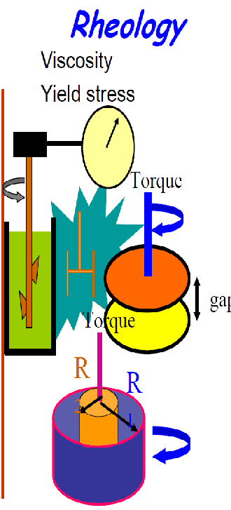
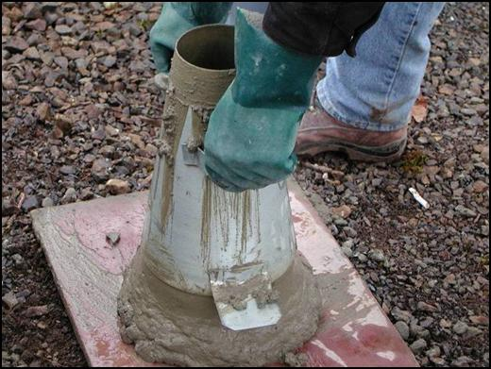
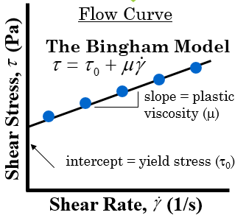

Concrete Rheology
Rheology is define as “Study flow and deformation of material under the influence of stresses”.
The main objective of rheology is predicting the fluid flow that would be produced due to applied forces.
The rheology of concrete – generally measured with a concrete rheometer, determines the resistance of concrete to shear flow at various shear rates.
Concrete rheology measurements are typically expressed in terms of the Bingham model, which is a function of:
  Yield stress: “The minimum force required to break down the structure of concrete and initiate flow” and it is related to slump.
  Plastic viscosity: “Resistance to flow, once concrete is flowing” and it is related to the time of concrete slumping (speed of the flow).
Results

Slide 7
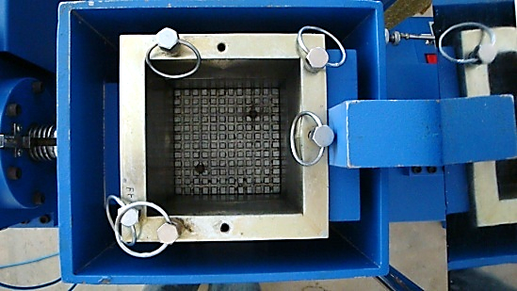
Concrete Shear Box
Moulds
Concrete Shear Box
Designed and Developed by
Dr.S.Girish and Dr.R.V.Ranganath
Professors,
B M S College of Engineering
Features of Instrument:
Size of Sample- 150mm x 150mm x 150mm.
Displacement Rate- 1 to 100 mm/min.
Normal Stress- 3.0MPa.
Load applied through Pneumatic Actuator.
Servo-controlled electronic data acquisition system.
Data Acquisition System

Slide 8
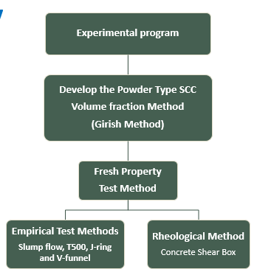
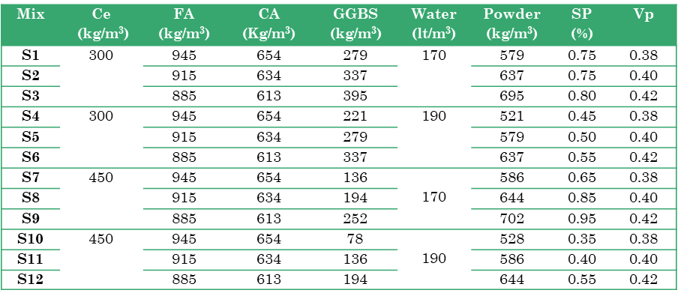
Experimental Work
Material Properties
Materials | Properties
Cement | Ordinary Portland Cement -53 grade, conforming to IS: 12269-2013. Specific Gravity=3.13. Specific surface=260 m²/kg (Blaine's method)
Fine aggregate | Natural river sand (Confirming to Zone-II) Specific Gravity=2.6. Water absorption=2.0%
Coarse aggregates | Crushed granite angular aggregates with combination of 20 mm and 12.5 mm down size. Specific Gravity=2.6. Water absorption=0.9%
Mineral admixture | Ground Granulated Blast-Furnace Slag (GGBS) -- Conforming to IS:12089 Specific Gravity=2.89. Specific surface=425 m²/kg (Blaine's method)
Chemical admixture | PCE based superplasticizer was used as HRWA confirming to IS: 9103. Specific gravity = 1.08, solids 35%
Details of Mix Proportions
Cement - 300 and 450 kg/cu-m
Water – 170 and 190 lt/cu-m
Powder – 521 to 702 kg/cu-m
Vp – 0.38 to 0.42
SP – Optimum dosage provided based on Marsh cone test
Ce – Cement; FA-Fine Aggregate; CA-Coarse Aggregate; SP- superplasticizer; Vp- Volume of paste

Slide 9
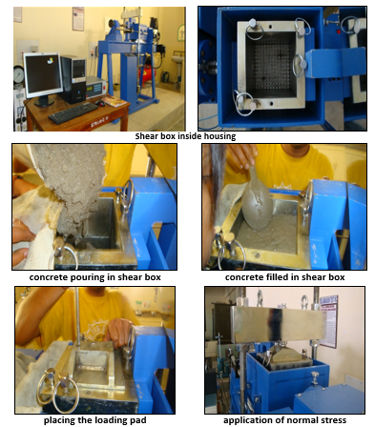
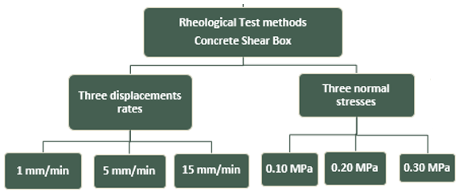
Experimental Methodology

Slide 10
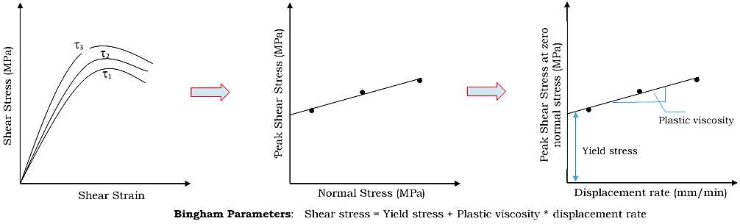
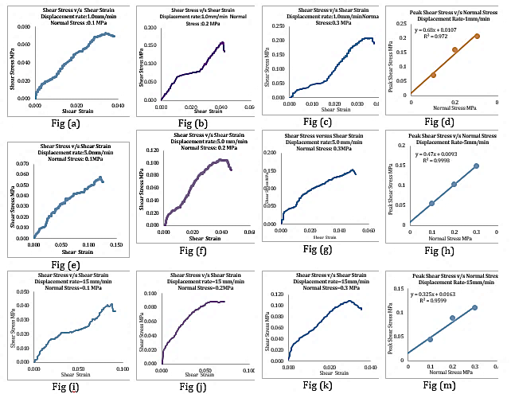
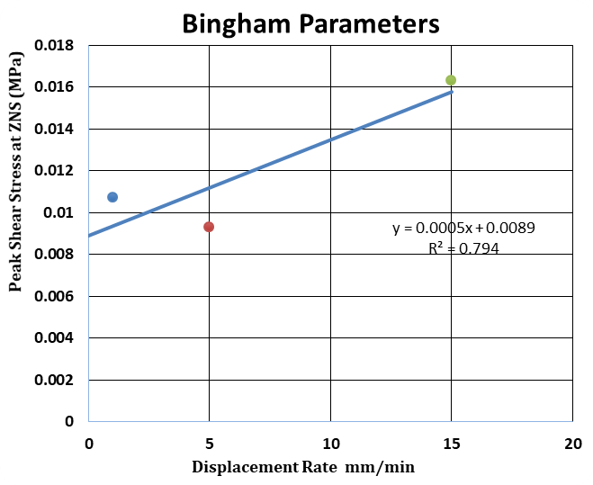
Experimental Methodology
Unique Generalized Procedure for finding the Rheological Properties by using Concrete Shear Box

Slide 11
Results and Discussion
Fresh Properties of SCC mixes along with Rheological values
Mix | Cement (kg/m³) | Water (lt/m³) | Vp | Slump (mm) | T_{500mm} (s) | V-funnel (s) |  | J-ring (mm) | Yield Stress (Pa) | Plastic viscosity (MPa-s)
 |  |  |  |  |  | V0 | V5
S1 | 300 | 170 | 0.38 | 750 | 4.7 | 8.0 | 8.0 | 4.0 | 8900 | 4.5
S2 |  |  | 0.40 | 770 | 3.8 | 8.5 | 8.9 | 3.0 | 6000 | 8.1
S3 |  |  | 0.42 | 850 | 3.5 | 10.0 | 10.8 | 5.0 | 3600 | 3.5
S4 | 300 | 190 | 0.38 | 720 | 2.0 | 5.0 | 5.0 | 10.0 | 12200 | 3.6
S5 |  |  | 0.40 | 730 | 2.2 | 5.2 | 5.5 | 3.0 | 8200 | 14.6
S6 |  |  | 0.42 | 750 | 2.5 | 5.5 | 6.0 | 10.0 | 6600 | 20.7
S7 | 450 | 170 | 0.38 | 690 | 3.2 | 8.0 | 8.5 | 0.0 | 6700 | 9.0
S8 |  |  | 0.40 | 800 | 3.0 | 8.0 | 9.0 | 0.0 | 4300 | 6.3
S9 |  |  | 0.42 | 850 | 2.8 | 8.5 | 10.0 | 5.0 | 3300 | 6.0
S10 | 450 | 190 | 0.38 | 680 | 2.7 | 7.0 | 7.2 | 5.0 | 26900 | 3.6
S11 |  |  | 0.40 | 700 | 2.3 | 7.4 | 7.8 | 5.0 | 13300 | 6.3
S12 |  |  | 0.42 | 725 | 2.4 | 8.5 | 8.8 | 5.0 | 8700 | 14.4
Constant Vp, water content, with higher cement content yield stress decreases.
Higher Vp the yield stress is reduced due to better coating of the aggregate particles and due to reduction in inter-particle friction.
Good correlation between slump flow and yield stress.
As the yield stress decreasing with increasing slump flow and vice versa.
Generally observe the correlation between slump and plastic viscosity to be average.

Slide 12
Concluding Remarks
The results of this experimental study have shown the effective use of new concrete shear box in determining the rheological properties of fresh concrete (SCC) and can be an effective additional tool.
The test is unique with consistent results and the values are obtained with normal stress and displacement rate at ‘zero’ values.
The Bingham parameters obtained through these studies were termed as ‘relative yield stress’ and ‘relative plastic viscosity’; partly due to higher than those reported in the literature as determined by rheometers with high shear rate.

Slide 13
References
Koehler and Fowler, Summary of Concrete Workability Test Methods, International Centre for Aggregate Research, ICAR-Report-105, 2003.
American Concrete Institute Code ACI: 238-1R.08 on Report on Measurements of Workability and Rheology of Fresh Concrete, 2008.
F.de.Larrard, Why Rheology Matters, Magazine of Concrete International, August, pp.79-81, 1999.
Koehler and Fowler, Development of a Portable rheometer for fresh Portland cement concrete, ICAR Report 105-3F, 2004.
Tattersall and Banfill, The Rheology of Fresh Concrete, Pitman Advanced Publishing, Boston, 1983.
S. Girish, R. V. Ranganath and Jagadish Vengala, Influence of powder and paste on flow properties of SCC, Construction and Building Materials, volume 24, issue 12, December, pp.2481–2488, 2010.
EFNARC Guideline-2002 and 2005, Specification and Guidelines for Self-Compacting Concrete, UK, http://www.efnarc.or
Girish. S and Ajay. N, Importance of rheological properties of fresh concrete - A review, The Indian Concrete Journal, September, Vol. 91, Issue 9, pp. 09-17, 2017.
S. Girish, Ajay. N, Girish Kumar S. and Hrushikesh M., A scientific approach to measure the workability of concrete using concrete shear box, The Indian Concrete Journal, March 2018, Vol. 92, Issue 3, pp. 24-35,2018.
S.Girish and B.S. Santhosh, Concrete Shear Test: A new tool for determining rheological properties of fresh Portland cement concrete, Advance in Civil Engineering and Building Materials, pp.289-293, 2011.
S. Girish and B. S. Santhosh , Determination of Bingham Parameters of Fresh Portland cement Concrete Using Concrete Shear Box, Bonfring International Journal of Industrial Engineering and Management Science, Vol. 02, No 04 SPL, December,pp.84-90, 2012.
S. Girish and B.S. Santhosh, A Unique Procedure for Finding the Rheological Properties of Fresh Portland Cement Concrete using Concrete Shear Tests, 1st International RILEM Conference on Rheology and processing of construction materials and 7th International RILEM symposium on Self-Compacting Concrete, 2-4thSeptember,Paris, France, pp.365-372,2013.

Slide 14
Thank You

